Slide 1


Macbeth
Act 2

Slide 2
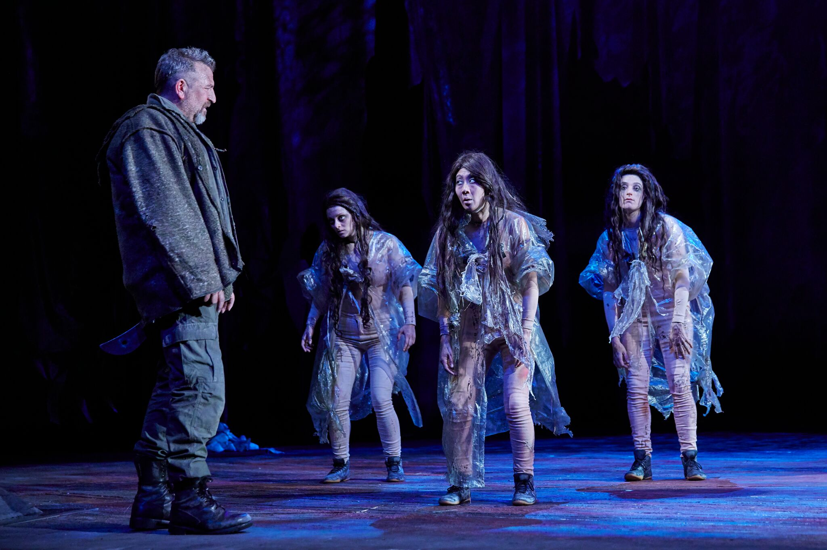
Dramatic conventions
Iambs
Pentameter
Soliloquy
Monologue
Aside
Stage directions
Sound
Language features
Acts/scenes
Characterisation
Plot
Setting
Dialogue

Slide 3
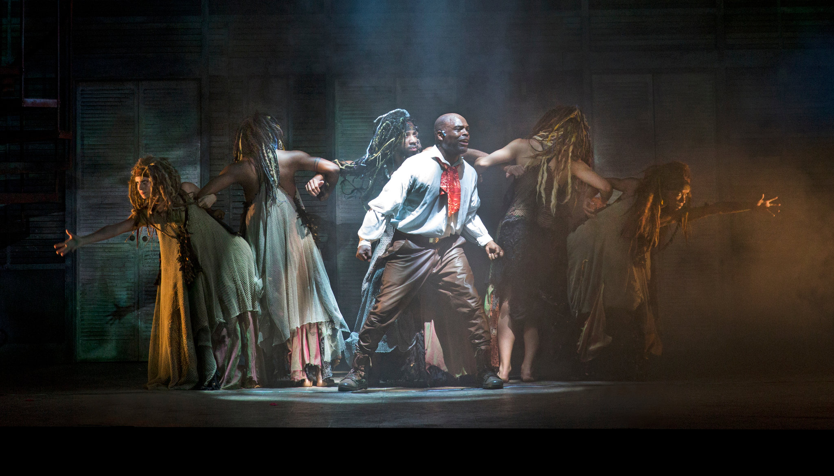
Soliloquy
Soliloquy refers to a monologue that is given when the character is alone. Monologues refer to long speeches given by a character.
Soliloquys work in Macbeth to explore the character’s inner thoughts and turmoil, and reveal deeper aspects of their characterisation.
Because they are alone, they reveal private thoughts and schemes.
Today we will be focusing on Macbeth’s soliloquy in Act 2.

Slide 4
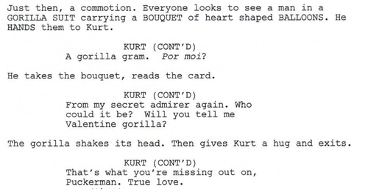

Stage directions and sound
Often in plays, these are embedded within the text like so:

Slide 5
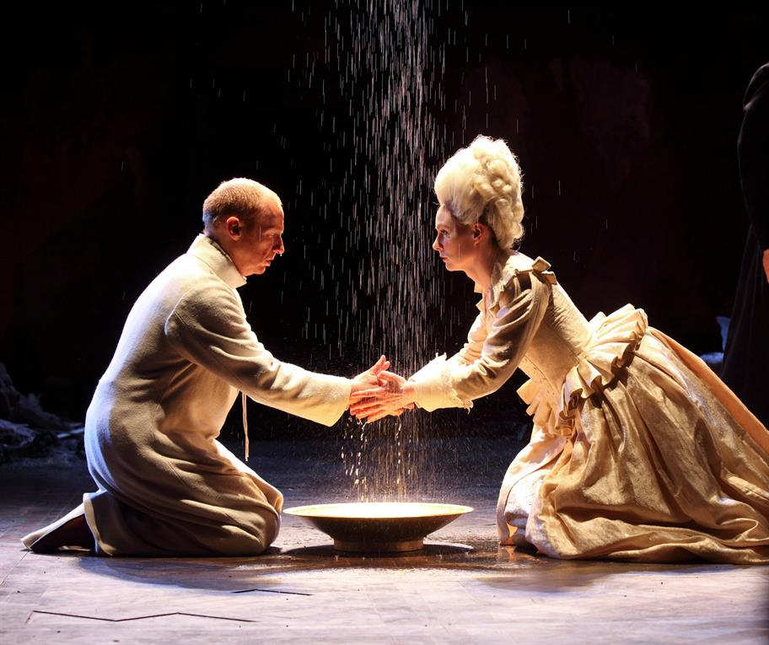
Stage directions and sound in Macbeth
There are some explicit stage and sound directions in the play. However, a lot of the movement is placed within the dialogue. This means it is intra dialogic (within dialogue) rather than extra dialogic (outside of dialogue).
If you were answering a question about the use of dramatic conventions within Macbeth, you will also need to be aware of the intra dialogic directions.
When we watch the performance of Macbeth’s Act 2 soliloquy, you will be able to see how the intra dialogic stage and sound directions work within the script.

Slide 6
Act 2, Scene 1
It is after midnight in Inverness. Banquo talks with his son Fleance and notices the stars aren't shining. He prays for angels to "restrain in me the cursed thoughts that nature gives way to in repose" (2.1.7-8).
Banquo is also struggling against ambition. Earlier Macbeth begged the stars to hide (1.4.51). They have.
Macbeth enters. Banquo tells Macbeth his sleep has been troubled by dreams of the weird sisters. Macbeth claims never to think about them. But he suggests they talk about the witches soon, and adds that if Banquo supports him when the time comes he'll reward and honour Banquo for it.
Banquo is open about the troubling "dreams" the witches have inspired in him. Macbeth, who has decided to act on his own selfish ambition, is not.
Banquo says he'll be receptive to what Macbeth has to say provided he loses no honour in seeking to gain more. Banquo and Fleance head off to bed.
Banquo believes true manhood means acting honourably—just what Macbeth used to believe.
Alone, Macbeth sees a bloody dagger floating in the air. He can't grasp it, and can't decide whether it's a phantom or his imagination. "Nature seems dead" to him (2.1.50).
As Macbeth gets closer to the murder, nature starts to go haywire.
Offstage, Lady Macbeth rings the bell to signal that Duncan's attendants are asleep. Macbeth goes to murder Duncan.
Interesting that in Macbeth, most of the violence happens offstage.

Slide 7
Activity
Close analysis of Macbeth’s soliloquy
Read the soliloquy in Act 2, Scene 1 and annotate for language features.
Write a short analysis (200 words) of your interpretation of the soliloquy, focusing on how it contributes to theme and characterisation.
Consider: what does this soliloquy reflect about Macbeth’s character? What does it foreshadow?

Slide 8
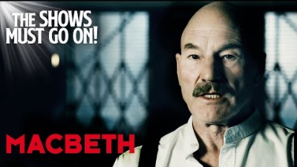

Slide 9
Is this a dagger which I see before me, The handle toward my hand? Come, let me clutch thee. I have thee not, and yet I see thee still. Art thou not, fatal vision, sensible To feeling as to sight? or art thou but A dagger of the mind, a false creation, Proceeding from the heat-oppressed brain? I see thee yet, in form as palpable As this which now I draw. Thou marshall’st me the way that I was going; And such an instrument I was to use. Mine eyes are made the fools o’ the other senses, Or else worth all the rest; I see thee still, And on thy blade and dudgeon gouts of blood, Which was not so before. There’s no such thing:
It is the bloody business which informs Thus to mine eyes. Now o’er the one halfworld Nature seems dead, and wicked dreams abuse The curtain’d sleep; witchcraft celebrates Pale Hecate’s offerings, and wither’d murder, Alarum’d by his sentinel, the wolf, Whose howl’s his watch, thus with his stealthy pace. With Tarquin’s ravishing strides, towards his design Moves like a ghost. Thou sure and firm-set earth, Hear not my steps, which way they walk, for fear Thy very stones prate of my whereabout, And take the present horror from the time, Which now suits with it. Whiles I threat, he lives: Words to the heat of deeds too cold breath gives.

Slide 10
Act 2, scene 2
Lady Macbeth waits in agitation for Macbeth to do the deed. She comments that had the sleeping Duncan not looked like her father she'd have killed him herself.
Lady Macbeth isn't completely cold-blooded, foreshadowing her future feelings of guilt.
Macbeth enters. He's killed Duncan. His hands are bloodstained and he's upset that when one of the attendants said "God bless us" in his sleep, he was unable to say "Amen." He also thought he heard a voice say "Macbeth does murder sleep" (2.2.34).
Bloodstained hands and sleeplessness: symbols of guilt. Macbeth is anguished: he knows the consequences of this murder.
Lady Macbeth soothes him and tells him to wash his hands, but notices he's still carrying the daggers he used to kill Duncan. Macbeth refuses to return to the scene of the crime. Lady Macbeth, furious, runs off to plant the daggers on the sleeping attendants.
Compare Macbeth's nervousness to Lady Macbeth's calm, collected behaviour.

Slide 11
Continued
A knock sounds, terrifying Macbeth. He worries that not all the water in the world could wash the blood from his hands.
The knock at the door parallels the "knocking" of Macbeth's heart in scene 1.3.
Lady Macbeth returns, her hands now as bloody as Macbeth's. But she's calm, and identifies the 'mysterious' knocking as someone at the south entrance. She says: "a little water clears us of this deed" (2.2.65), and tells Macbeth to go and put his nightgown on so no one will suspect them.
Lady Macbeth is calm. She identifies the "mysterious" knocking as someone at the South entrance. But she is naïve, thinking water can wash away her guilt.
Macbeth wishes that the knocking could wake Duncan.
Macbeth shows remorse.

Slide 12
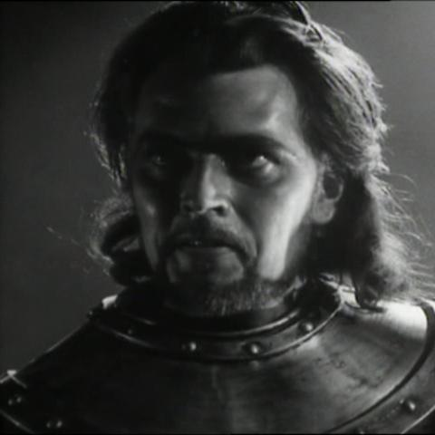
Act 2, Scene 3
Comic relief of the porter – research why Shakespeare’s play consistently have moments of comic relief? What purpose does it serve? Is it typical of plays within his context?
This scene also explores the contrast between Macbeth and Macduff – namely Macduff’s integrity and Macbeth’s ability to deceive.
In this scene, there is also the realisation that any of the thanes could be the murderer. How does this contribute to the themes of disorder and deceit?

Slide 13
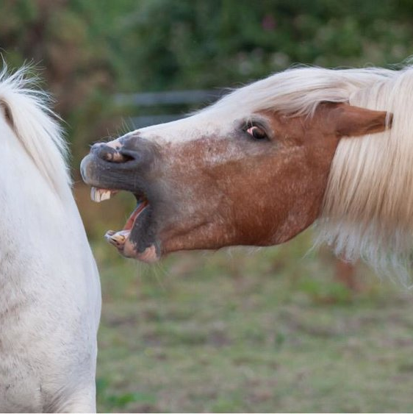
Act 2, Scene 4
Ross and an old man discuss the havoc in the natural world that is occurring. For example, darkness during the day, owls killing hawks, and horses eating one another. Consider why imagery of unnatural occurrences within nature is repeated throughout Macbeth. What purpose does this serve?
While a lot of the violence occurs off-stage, the imagery conveyed through dialogue is extremely graphic and violent in nature. How does this contribute to the mood of the play? What is the Elizabethan relationship with nature and the natural order?

Slide 14
Act 2, Scene 4
This act ends with suspicion, despite Macbeth’s plan working and Duncan’s attendants being blamed for his death. Malcolm and Donaldbain are thought to be behind the plot, making Duncan’s murder not only regicide, but patricide.
Analysis:
Look back through Act 2 and find evidence for the following themes:
Nature and the unnatural
Violence
Ambition
Fate

